Slide 1
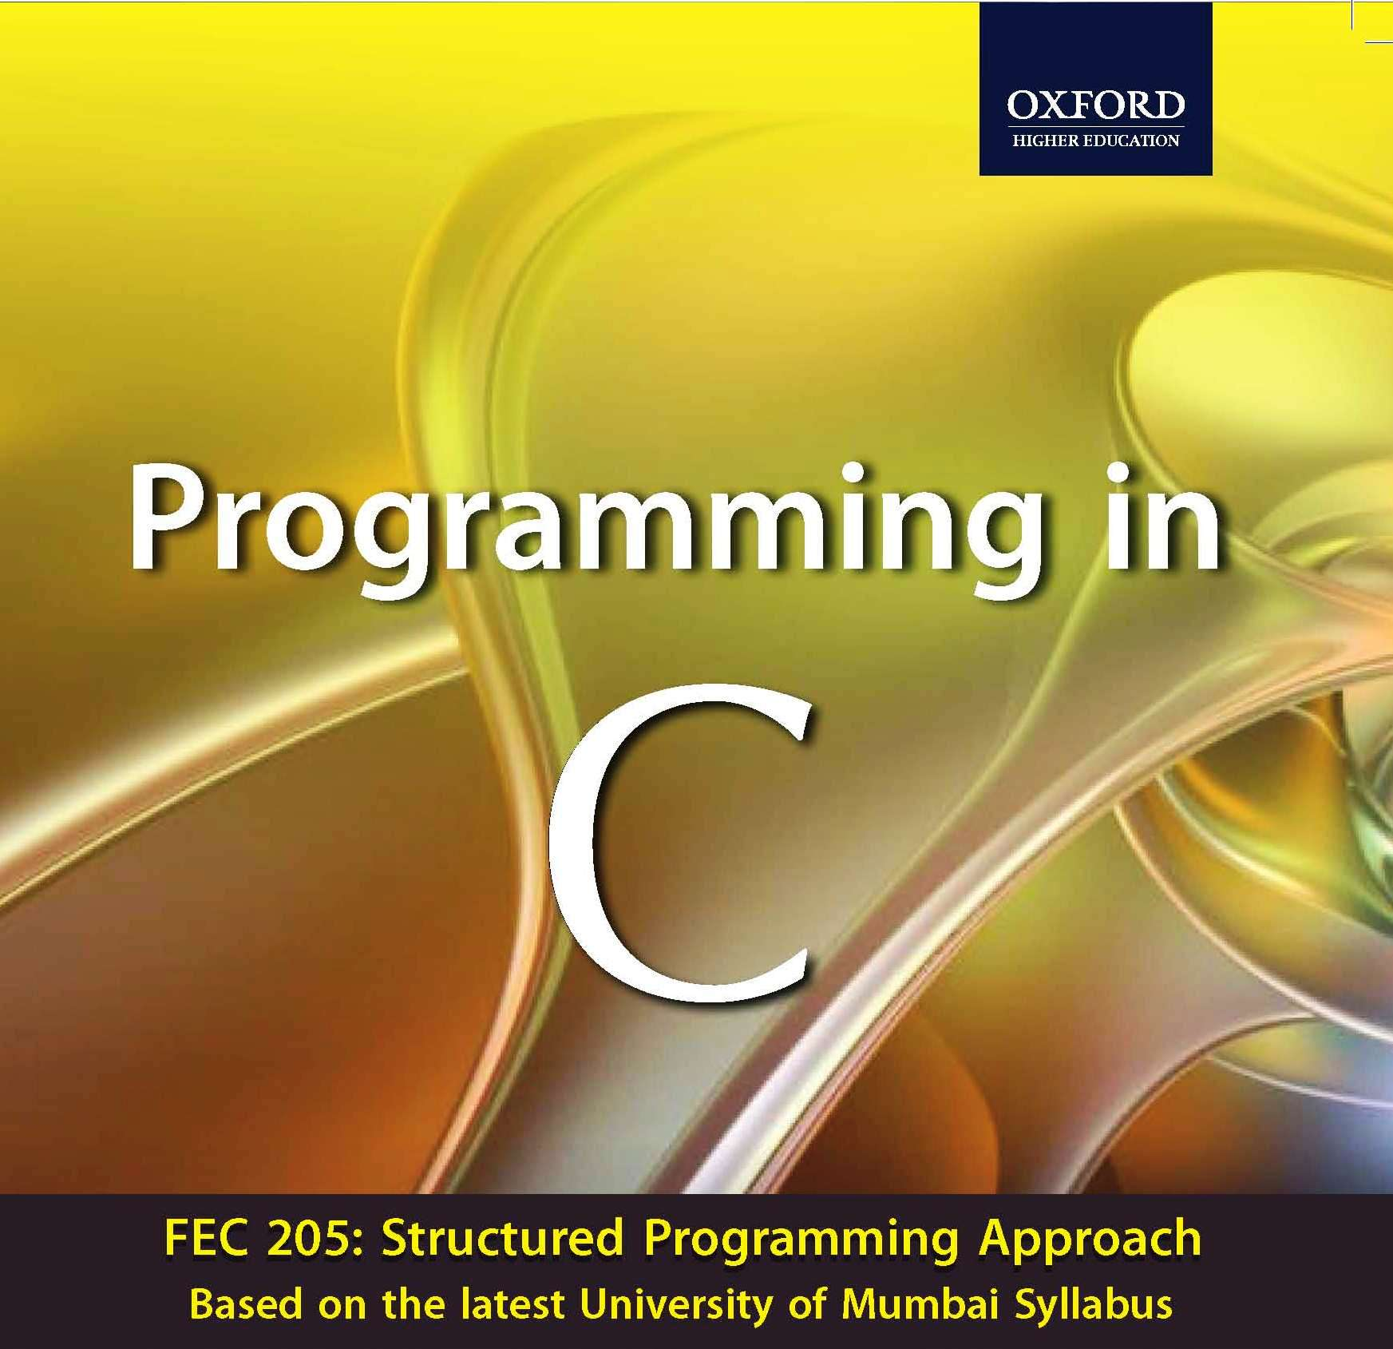


Slide 2
Control Statements in ‘C’
Chapter 4

Slide 3
1. Learning objectives
Understanding meaning of a statement and statement block
Learn about decision type control constructs in C and the way these are used
Learn about looping type control constructs in C and the technique of putting them to use
Learn the use of special control constructs such as goto, break, continue, and return
Learn about nested loops and their utility

Slide 4
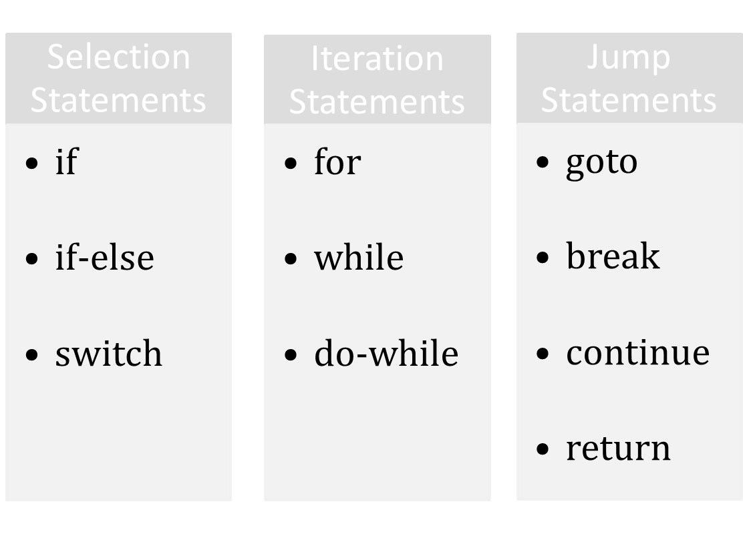
2. Control Statements include

Slide 5
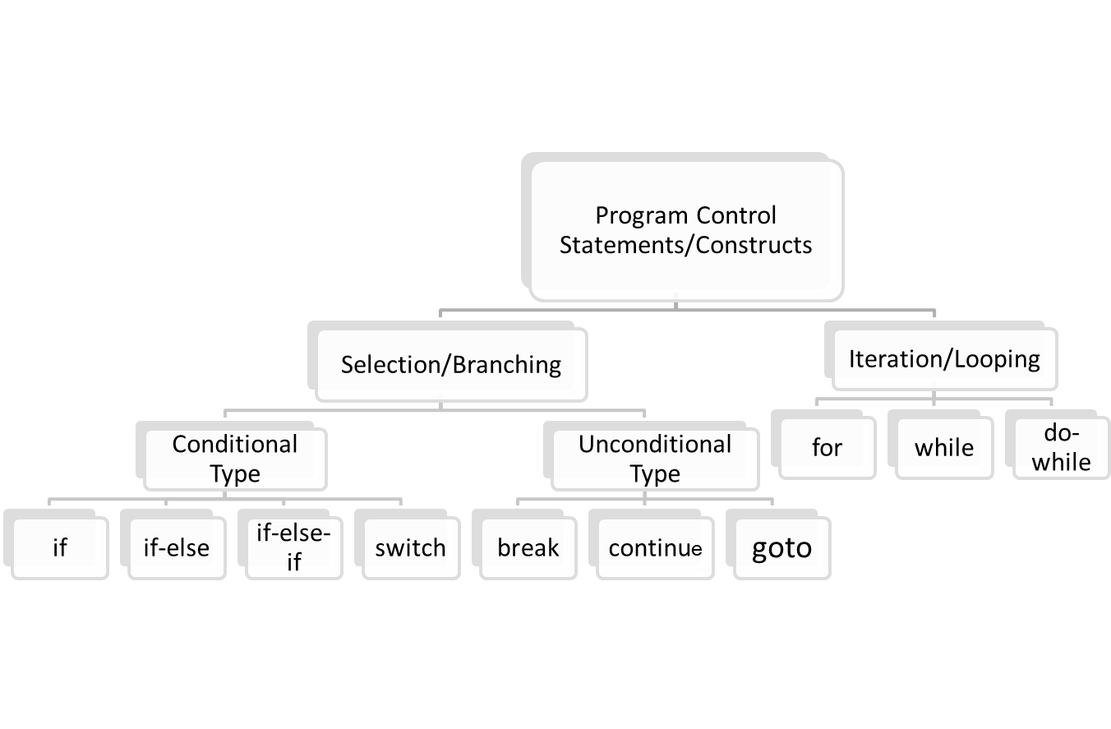
3. Program Control Statements/Constructs in ‘C’

Slide 6
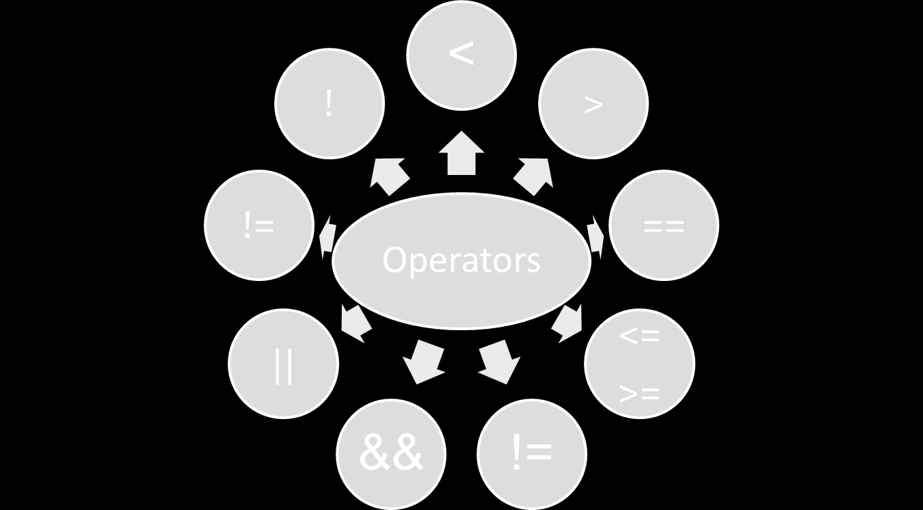
4. OPERATORS

Slide 7
4.1. Relational Operators
4.2. Equality and Logical Operators
To Specify | Symbol Used
less than | <
greater than | >
less than or equal to greater than or equal to | <= >=
To Specify | Symbol Used
Equal to | ==
Not equal to | !=
Logical AND | &&
Logical OR | ||
Negation | !

Slide 8
Points to Note
If an expression, involving the relational operator, is true, it is given a value of 1. If an expression is false, it is given a value of 0. Similarly, if a numeric expression is used as a test expression, any non-zero value (including negative) will be considered as true, while a zero value will be considered as false.
Space can be given between operand and operator (relational or logical) but space is not allowed between any compound operator like <=, >=, ==, !=. It is also compiler error to reverse them.
a == b and a = b are not similar, as == is a test for equality, a = b is an assignment operator. Therefore, the equality operator has to be used carefully.
The relational operators have lower precedence than all arithmetic operators.

Slide 9
A Few Examples
The following declarations and initializations are given:
int x=1, y=2, z=3;
Then,
The expression x>=y evaluates to 0 (false).
The expression x+y evaluates to 3 (true).
The expression x=y evaluates to 2 (true).

Slide 10
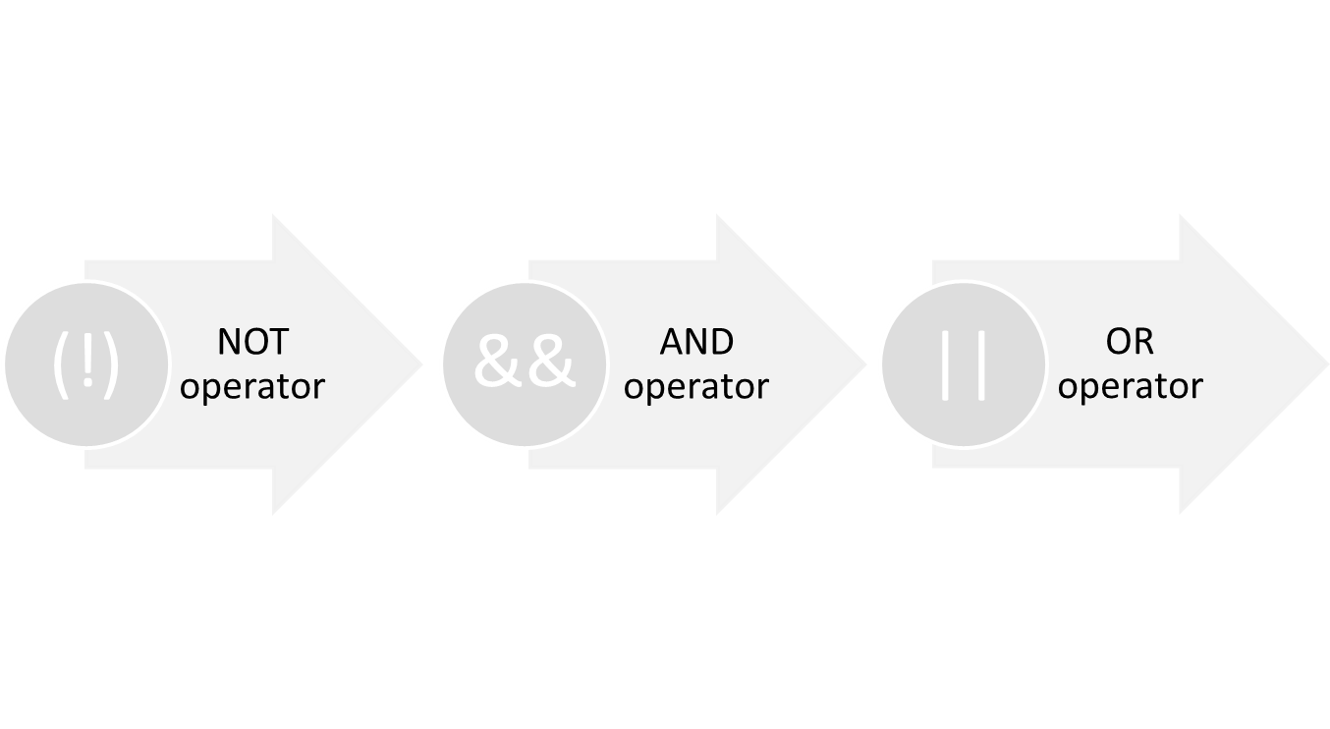
Logical operators may be mixed within relational expressions but one must abide by their precedence rules which is as follows:

Slide 11
4.3. Operator Semantics
Operators | Associativity
() ++ (postfix) -- (postfix) | left to right
+ (unary) - (unary) | right to left
++ (prefix) -- (prefix) * / % | left to right
+ - | left to right
< <= > >= | left to right
== != | left to right
&& | left to right
|| | left to right
?: | right to left
= + = - = * = / = | right to left
, (comma operator) | left to right

Slide 12
5. Conditional Execution and Selection
Selection Statements
The Conditional Operator
The switch Statement

Slide 13
5.1. Selection Statements
5.1.1 One-way decisions using if statement
5.1.2 Two-way decisions using if-else statement
5.1.3 Multi-way decisions
5.1.4 Dangling else Problem

Slide 14
5.1.1 One-way decisions using if statement
Flowchart for if construct
if(TestExpr)
stmtT; T F
TestExpr
stmtT

Slide 15
Write a program that prints the largest among three numbers.
Algorithm | C Program
1. START | #include <stdio.h> int main() { int a, b, c, max; printf(“\nEnter 3 numbers”); scanf(“%d %d %d”, &a, &b, &c); max=a; if(b>max) max=b; if(c>max) max=c; printf(“Largest No is %d”, max); return 0; }
2. PRINT “ENTER THREE NUMBERS”
3. INPUT A, B, C
4. MAX=A
5. IF B>MAX THEN MAX=B
6. IF C>MAX THEN MAX=C
7. PRINT “LARGEST NUMBER IS”, MAX
8. STOP

Slide 16


5.1.2 Two-way decisions using if-else statement
Flowchart of if-else construct
TestExpr
The form of a two-way decision is as follows:
if(TestExpr)
stmtT;
else
stmtF;
T F
stmtT
stmtF

Slide 17
Write a program that prints the largest among three numbers.
Algorithm | C Program
1. START | #include <stdio.h> int main() { int a, b, c, max; printf(“\nEnter 3 numbers”); scanf(“%d %d %d”, &a, &b, &c); max=a; if(b>max) max=b; if(c>max) max=c; printf(“Largest No is %d”, max); return 0; }
2. PRINT “ENTER THREE NUMBERS”
3. INPUT A, B, C
4. MAX=A
5. IF B>MAX THEN MAX=B
6. IF C>MAX THEN MAX=C
7. PRINT “LARGEST NUMBER IS”, MAX
8. STOP

Slide 18
5.1.3 Multi-way decisions
General format of switch statements
if(TestExpr1)
stmtT1;
else if(TestExpr2)
stmtT2;
else if(TestExpr3)
stmtT3;
.. .
else if(TestExprN)
stmtTN;
else
stmtF;
switch(expr)
{
case constant1: stmtList1;
break;
case constant2: stmtList2;
break;
case constant3: stmtList3;
break;
………………………….
………………………….
default: stmtListn;
}
if-else-if ladder

Slide 19
Flowchart of an if-else-if Construct
TestExpr
TestExpr2
TestExpr3
stmtT1
TestExprN
stmtT2
stmtT3
stmtTF
stmtTN

Slide 20
The following program checks whether a number given by the user is zero, positive, or negative.
#include <stdio.h>
int main()
{
int x;
printf(“\n ENTER THE NUMBER:”);
scanf(“%d”, &x);
if(x > 0)
printf(“x is positive \n”);
else if(x == 0)
printf(“x is zero \n”);
else
printf(“x is negative \n”);
return 0;
}

Slide 21
Nested if
When any if statement is written under another if statement, this cluster is called a nested if.
The syntax for the nested is given here:
Construct 1 | Construct 2
if(TestExprA) if(TestExprB) stmtBT; else stmtBF; else stmtAF; | if(TestExprA) if(TestExprB) stmtBT; else stmtBF; else if(TestExprC) stmtCT; else stmtCF;

Slide 22
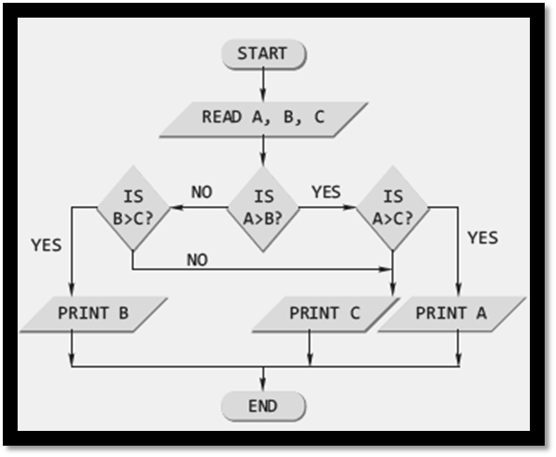
A program to find the largest among three numbers using the nested loop
#include <stdio.h>
int main()
{
int a, b, c;
printf(“\nEnter the three numbers”);
scanf(“%d %d %d”, &a, &b, &c);
if(a > b)
if(a > c)
printf(“%d”, a);
else
printf(“%d”, c);
else
if(b > c)
printf(“%d”, b);
else
printf(“%d”, c);
return 0;
}

Slide 23
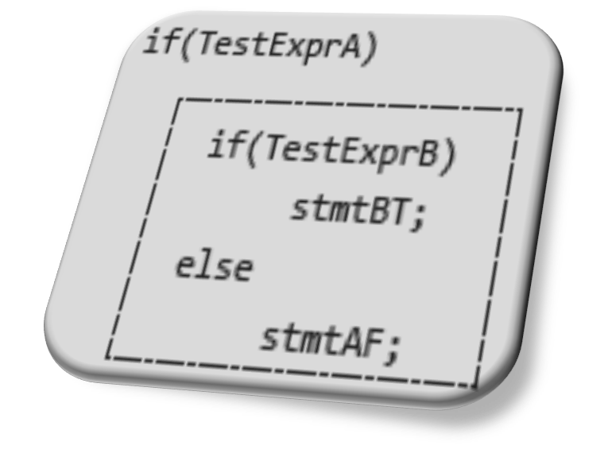
5.1.4 Dangling else problem
This classic problem occurs when there is no matching else for each if. To avoid this problem, the simple C rule is that always pair an else to the most recent unpaired if in the current block. Consider the illustration shown here.
The else is automatically paired with the closest if. But, it may be needed to associate an else with the outer if also.

Slide 24
Solutions to dangling else problem
Use of null else
Use of braces to enclose the true action of the second if
With null else | With braces
if(TestExprA) if(TestExprB) stmtBT; else ; else stmtAF; | if(TestExprA) { if(TestExprB) stmtBT; } else stmtAF;

Slide 25


6. The conditional operator
It has the following simple format:
expr1 ? expr2 : expr3
It executes by first evaluating expr1, which is normally a relational expression, and then evaluates either expr2, if the first result was true, or expr3, if the first result was false.
#include <stdio.h>
int main()
{
int a,b,c;
printf(“\n ENTER THE TWO NUMBERS:”);
scanf(“%d %d”, &a, &b);
c=a>b? a : b>a ? b :-1;
if(c==-1)
printf(“\n BOTH NUMBERS ARE EQUAL”);
else
printf(“\n LARGER NUMBER IS %d”,c);
return 0;
}
An Example

Slide 26
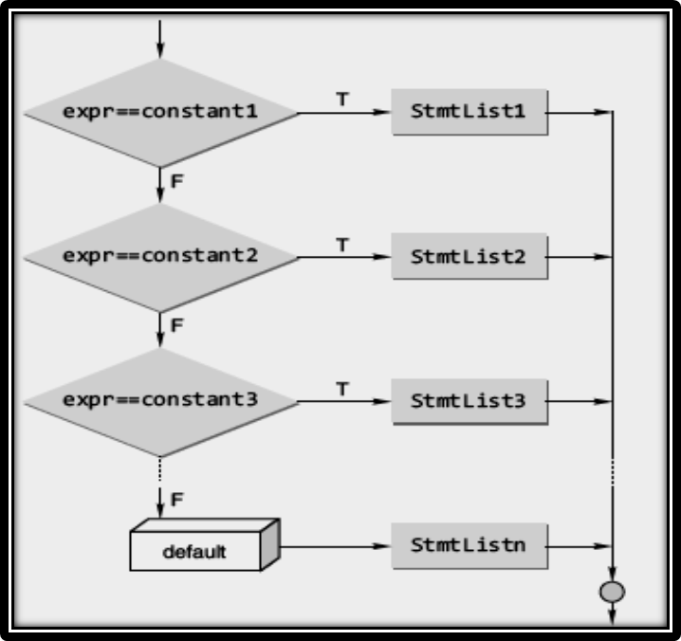
7. The switch statement
The general format of a switch statement is
switch(expr)
{
case constant1: stmtList1;
break;
case constant2: stmtList2;
break;
case constant3: stmtList3;
break;
………………………….
………………………….
default: stmtListn;
}
The C switch construct

Slide 27
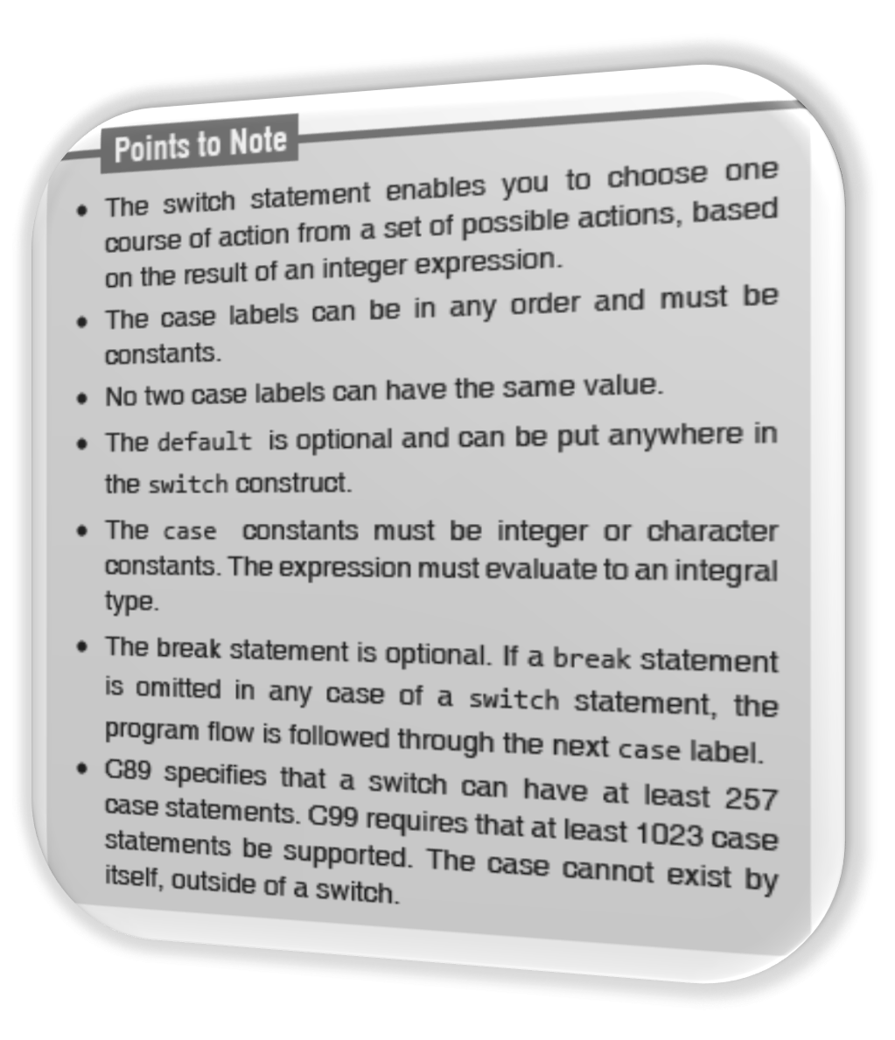

Slide 28
switch vs nested if
The switch differs from the else-if in that switch can test only for equality, whereas the if conditional expression can be of a test expression involving any type of relational operators and/or logical operators.
A switch statement is usually more efficient than nested ifs.
The switch statement can always be replaced with a series of else-if statements.

Slide 29
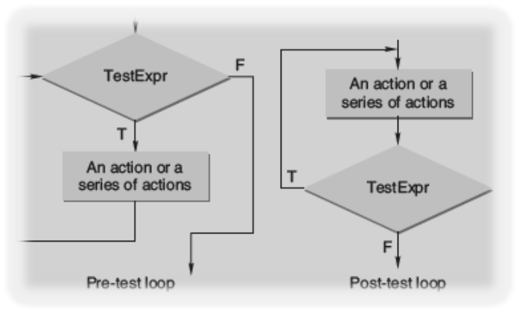
8. Iteration and Repetitive Execution
A loop allows one to execute a statement or block of statements repeatedly. There are mainly two types of iterations or loops – unbounded iteration or unbounded loop and bounded iteration or bounded loop.
A loop can either be a pre-test loop or be a post-test loop as illustrated in the diagram.

Slide 30
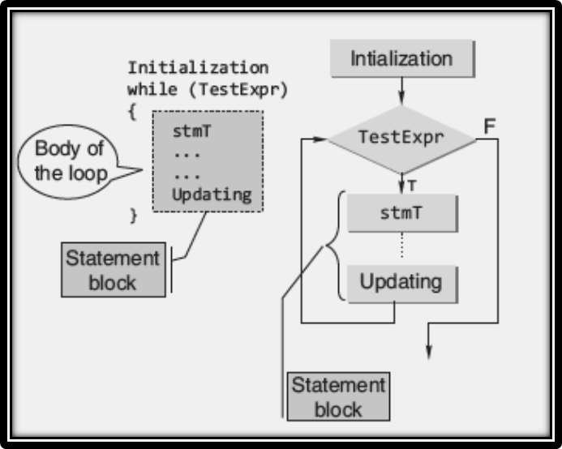
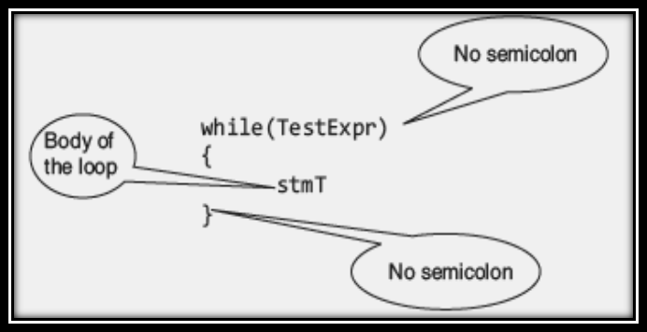
8.1 “while” construct
Expanded Syntax of “while” and its Flowchart Representation
while statement is a pretest loop. The basic syntax of the while statement is shown below:

Slide 31
An Example
#include <stdio.h>
int main()
{
int c;
c=5; // Initialization
while(c>0)
{ // Test Expression
printf(“ \n %d”,c);
c=c-1; // Updating
}
return 0;
}
This loop contains all the parts of a while loop. When executed in a program, this loop will output
5
4
3
2
1

Slide 32
Testing for floating-point ‘equality’
float x;
x = 0.0;
while(x != 1.1)
{
x = x + 0.1;
printf(“1.1 minus %f equals %.20g\n”, x, 1.1 -x);
}
The above loop never terminates on many computers, because 0.1 cannot be accurately represented using binary numbers.
Never test floating point numbers for exact equality, especially in loops.
The correct way to make the test is to see if the two numbers are ‘approximately equal’.

Slide 33
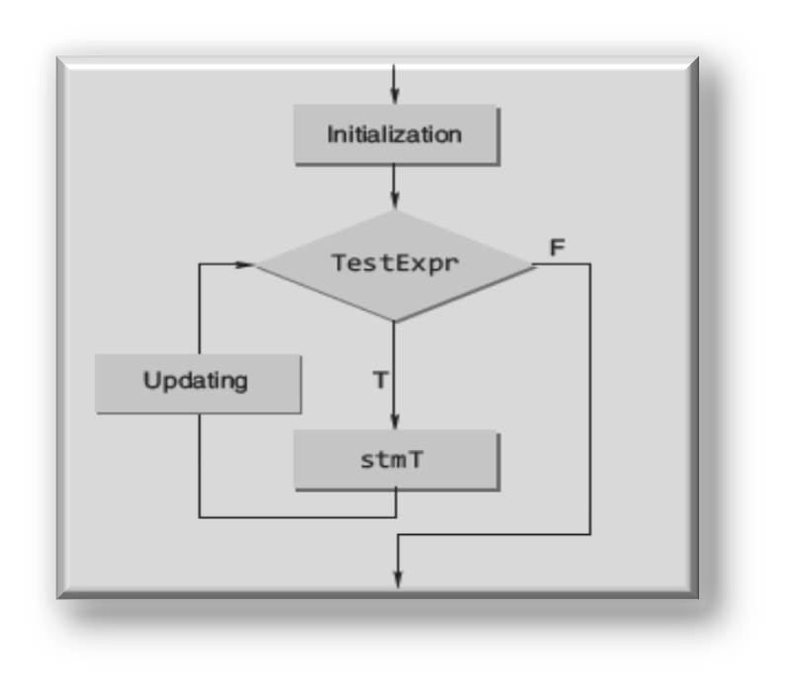
8.2 “for” Construct
The general form of the for statement is as follows:
for(initialization; TestExpr; updating)
stmT;
for construct
flow chart

Slide 34

Example
#include <stdio.h>
int main()
{
int n, s=0, r;
printf(“\n Enter the Number”);
scanf(“%d”, &n);
for(;n>0;n/=10)
{
r=n%10;
s=s+r;
}
printf(“\n Sum of digits %d”, s);
return 0;
}

Slide 35
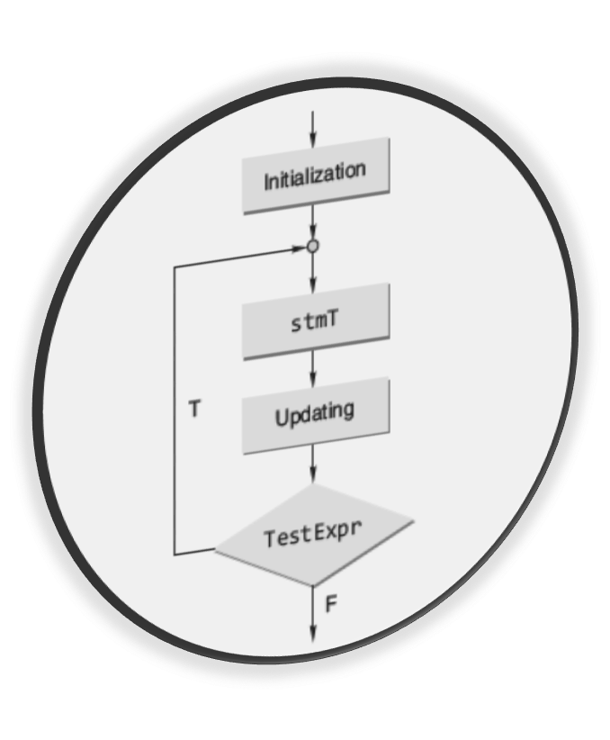

8.3 “do-while” Construct
The C do-while loop
The form of this loop construct is as follows:
do
{
stmT; /* body of statements would be placed here*/
}while(TestExpr);

Slide 36
Point to Note
With a do-while statement, the body of the loop is executed first and the test expression is checked after the loop body is executed. Thus, the do-while statement always executes the loop body at least once.

Slide 37
An Example
#include <stdio.h>
int main()
{
int x = 1;
int count = 0;
do {
scanf(“%d”, &x);
if(x >= 0) count += 1;
} while(x >= 0);
return 0;
}

Slide 38
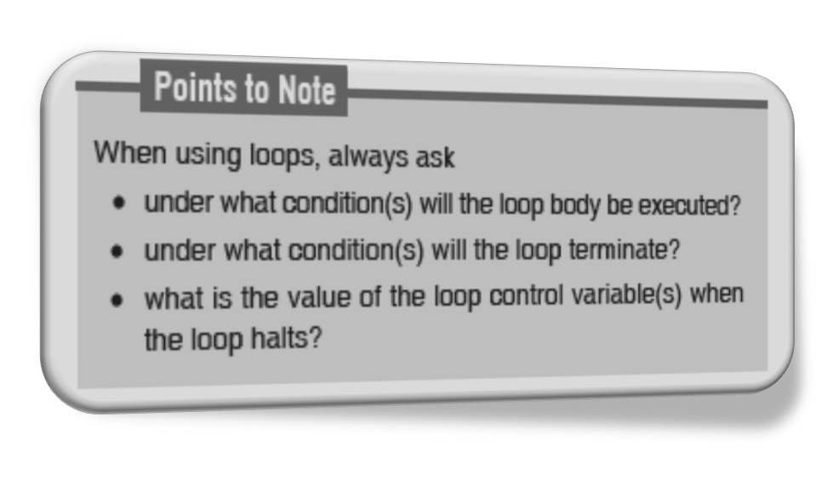
Which loop should be used???

Slide 39
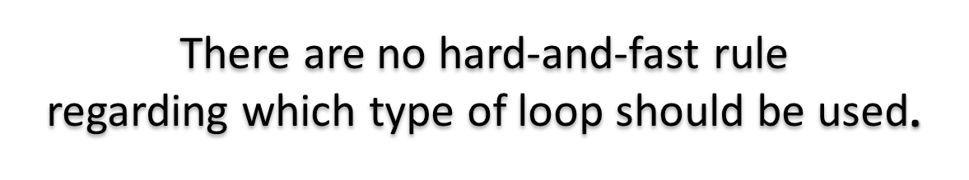
Some methods of controlling repetition in a program are:
Using Sentinel Values
Using Prime Read
Using Counter

Slide 40
9. GOTO STATEMENT
The following program is used to find the factorial of a number.
#include <stdio.h>
int main()
{
int n, c;
long int f=1;
printf(“\n Enter the number:”);
scanf(“%d”,&n);
if(n<0)
goto end;
for(c=1; c<=n; c++)
f*=c;
printf(“\n FACTORIAL IS %ld”, f);
end:
return 0;
}
The control is unconditionally transferred to the statement associated with the label specified in the goto statement. The form of a goto statement is
goto label_name;

Slide 41
10. SPECIAL CONTROL STATEMENTS
“return” statements
“break” statements
“continue” statements

Slide 42
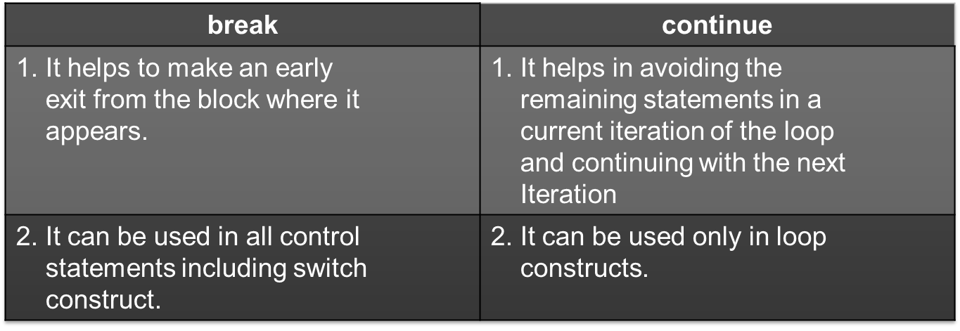
“break” and “continue” statements

Slide 43
11. NESTED LOOPS
A nested loop refers to a loop that is contained within another loop.
If the following output has to be obtained on the screen
1
2 2
3 3 3
4 4 4 4
then the corresponding program will be
#include <stdio.h>
int main()
{
int row, col;
for(row=1;row<=4;++row)
{
for(col=1;col<=row;++col)
printf(“%d \t”, row);
printf(“\n”);
}
return 0;
}

Slide 44
12. Common programming errors
Writing expressions like a<b<c or a==b==c etc.
Use of = instead of ==
Forgetting to use braces for compound statement
Dangling else
Use of semicolon in loop
Floating point equality

